Slide 1
PROJECT TITLE
CAPSTONE PROJECT
Presented By:
Student Name- Kuthadi Manasa Venkata Naga Sruthi
College Name- Dmssvh college of engineering
Department- Computer Science and Engineering

Slide 2
OUTLINE
Problem Statement (Should not include solution)
System Development Approach (Technology Used)
Algorithm & Deployment (Step by Step Procedure)
Result
Conclusion
Future Scope(Optonal)
References

Slide 3
Problem Statement
Manual estimation of employee salaries often leads to inaccuracies and inconsistencies due to human bias and a lack of data-driven benchmarks. With growing datasets and increased reliance on analytics in HR, there is a need for an intelligent system that can accurately predict salaries based on various employee features like education, experience, job role, and location. The existing systems fail to generalize across industries or roles and don’t consider trends in real-time data.

Slide 4
System Approach
Language: Python
Libraries: pandas, numpy, scikit-learn, matplotlib, seaborn, joblib
ML Models: Linear Regression, Random Forest Regressor, Decision Tree, XGBoost
Data Handling: CSV-based datasets from Kaggle or similar sources
(Optional UI): Streamlit or Flask (for deployment)
IDE/Tools: Jupyter Notebook / VS Code

Slide 5
Algorithm & Deployment
1. Data Collection
Collect employee data: Experience, Education, Job Role, Location, Company Size, Salary.
Data Preprocessing
Encode categorical variables.
Scale numerical features (if needed).
Handle missing values.
Exploratory Data Analysis (EDA)
Visualize data (bar plots, correlation heatmap).
Identify key factors affecting salary.
Model Building
Split data into training and testing sets.
Train models: Linear Regression, Random Forest, etc.
Model Evaluation
Evaluate using R², MAE, MSE.
Compare models' performance.
Model Selection
Choose the model with the best accuracy and lowest error.
Deployment
Save the model using joblib.
Create a simple user interface using Streamlit or Flask for predictions.

Slide 6
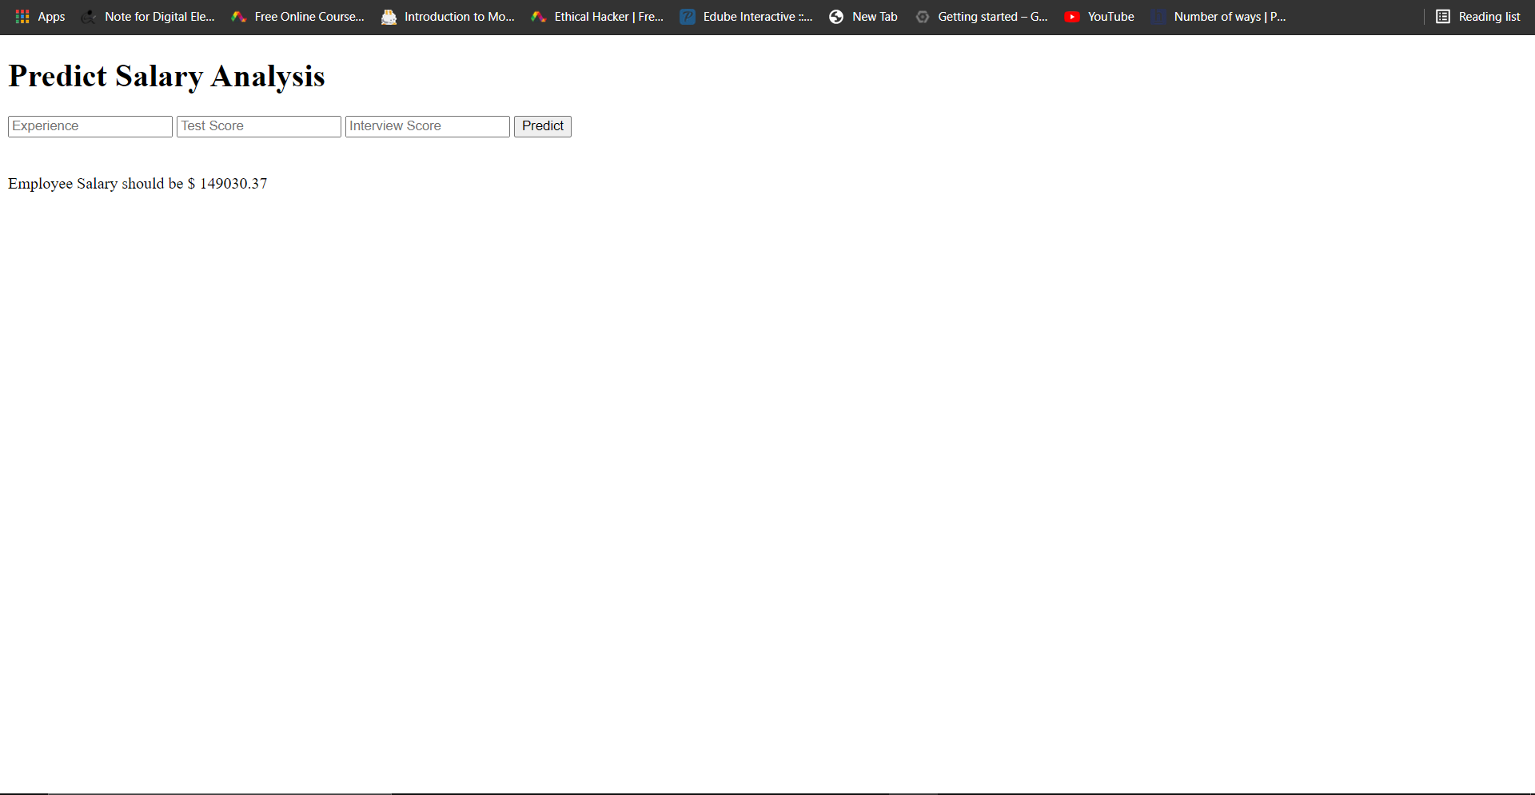
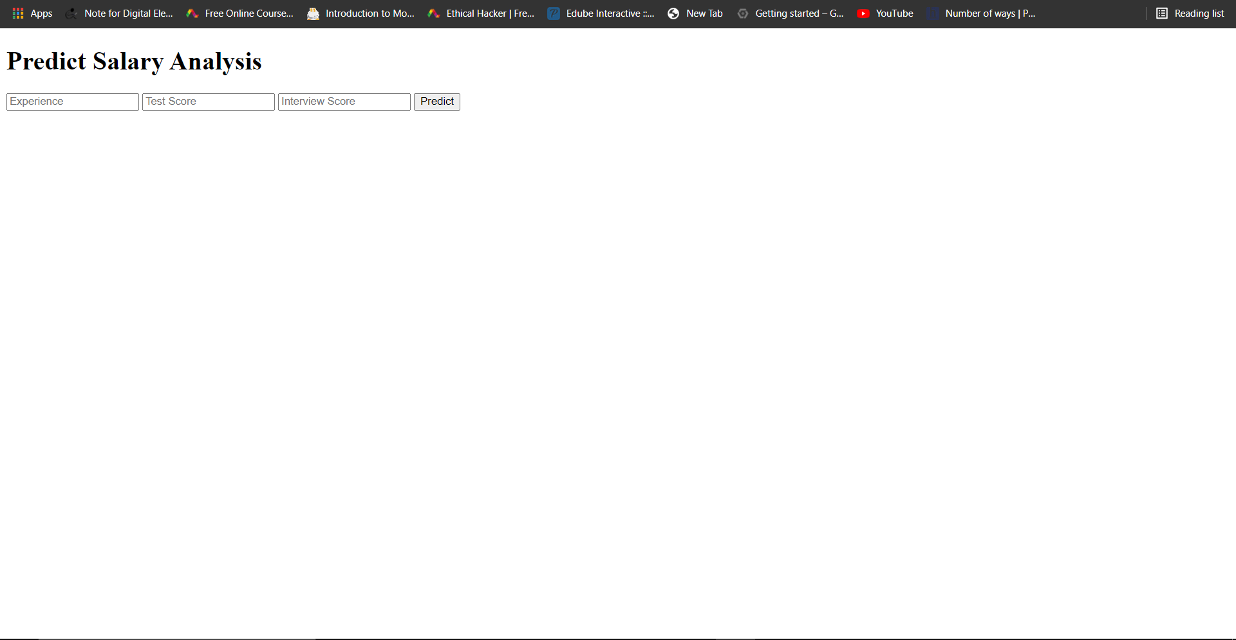
Result
Github link:-https://github.com/Manasa272/AIML-Manasa-Project-.git

Slide 7
Conclusion
This project successfully demonstrates how Machine Learning can be applied to solve real-world HR problems such as salary estimation. It reduces bias, increases consistency in compensation analysis, and offers a smart decision-support tool for HR departments.

Slide 8
Future scope(Optional)
Include additional features such as certifications, skills, or performance metrics.
Integrate real-time job market data from job portals.
Build a dynamic dashboard for HR professionals.
Expand the dataset for industry-specific predictions.

Slide 9
References
Kaggle Dataset: Salary Prediction
Scikit-learn Documentation: https://scikit-learn.org/
Streamlit Docs: https://docs.streamlit.io/
Python Official Docs: https://docs.python.org/

Slide 10
THANK YOU

